Slide 1

Patrones Hermosos

Slide 2

Information Hiding
I want to find out the average age of everyone in the class… but maybe you’d rather not tell me your age individually.
Notes:
Talk about relevance in medical field

Slide 3
Solution
1st Person: choose a random number + add your age to random number. Write this on new note.
Passes note to next person
Next Person: adds their age to number. Write this on new note.
Pass note to next person
Etc...
Finally: 1st Person removes random number from last note + divide by # people in group to get age average
Notes:
Talk about relevance in medical field

Slide 4
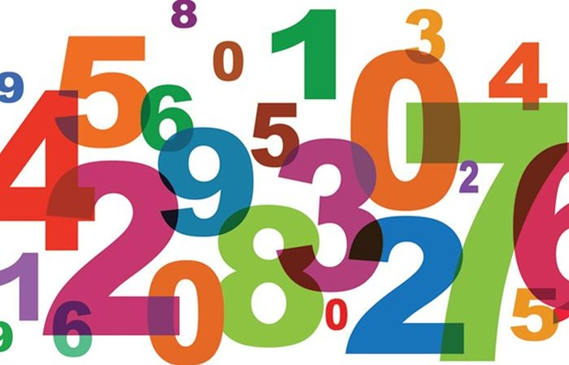
Sorting
If I give you a stack of playing cards, how will you sort them? Write down the pattern.
Notes:
Have stickies on the board: have them come up and sort (have to have some notion of a counter…)

Slide 5
Let’s Try Sorting Ourselves
Everyone will get a numbered card

Slide 6
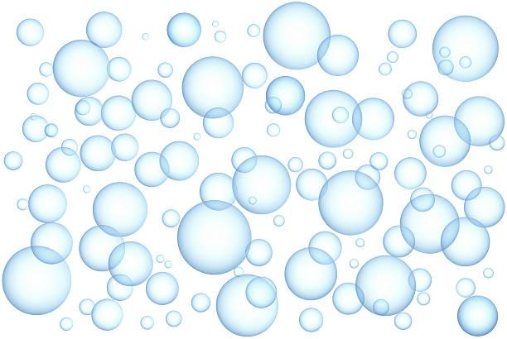
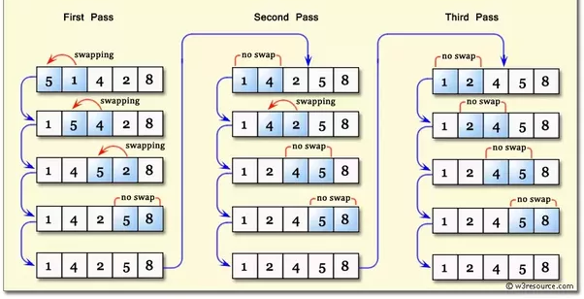
Bubble Sort
https://www.youtube.com/watch?v=lyZQPjUT5B4
Notes:
Can anyone think why it might be called bubble sort?

Slide 7
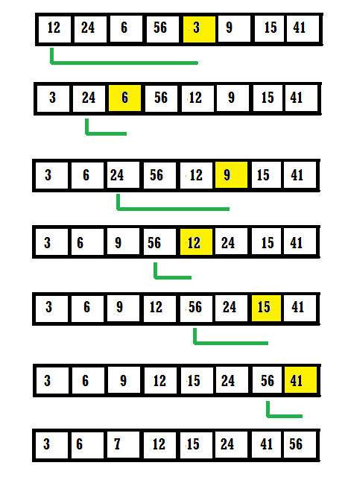
Selection Sort
At each pass, find the maximum number from the part of the array that still hasn’t been sorted and move it to the end of the unsorted portion.
https://www.toptal.com/developers/sorting-algorithms

Slide 8
Sorting
What are some disadvantages of these sorting algorithms?
Notes:
Have stickies on the board: have them come up and sort (have to have some notion of a counter…)

Slide 9
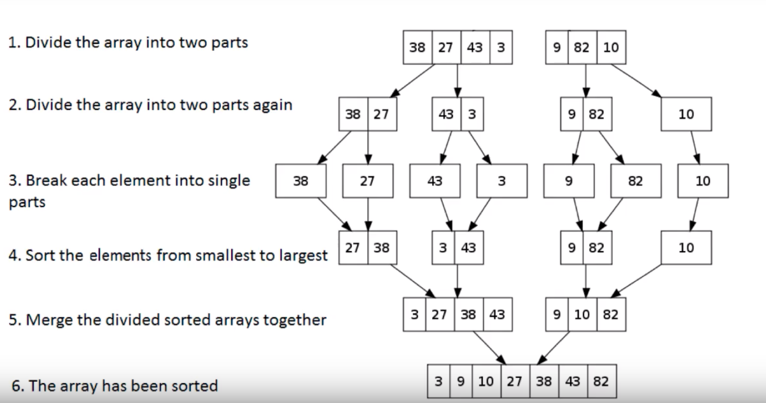
Merge Sort - faster!

Slide 10
Some Visuals
https://www.toptal.com/developers/sorting-algorithms

Slide 11



C
B
A
D
H
F
E
G
G
I

Slide 12
C
B
A
H
E
G

Slide 13

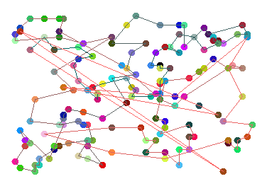
The Travelling Salesman Problem

Slide 14
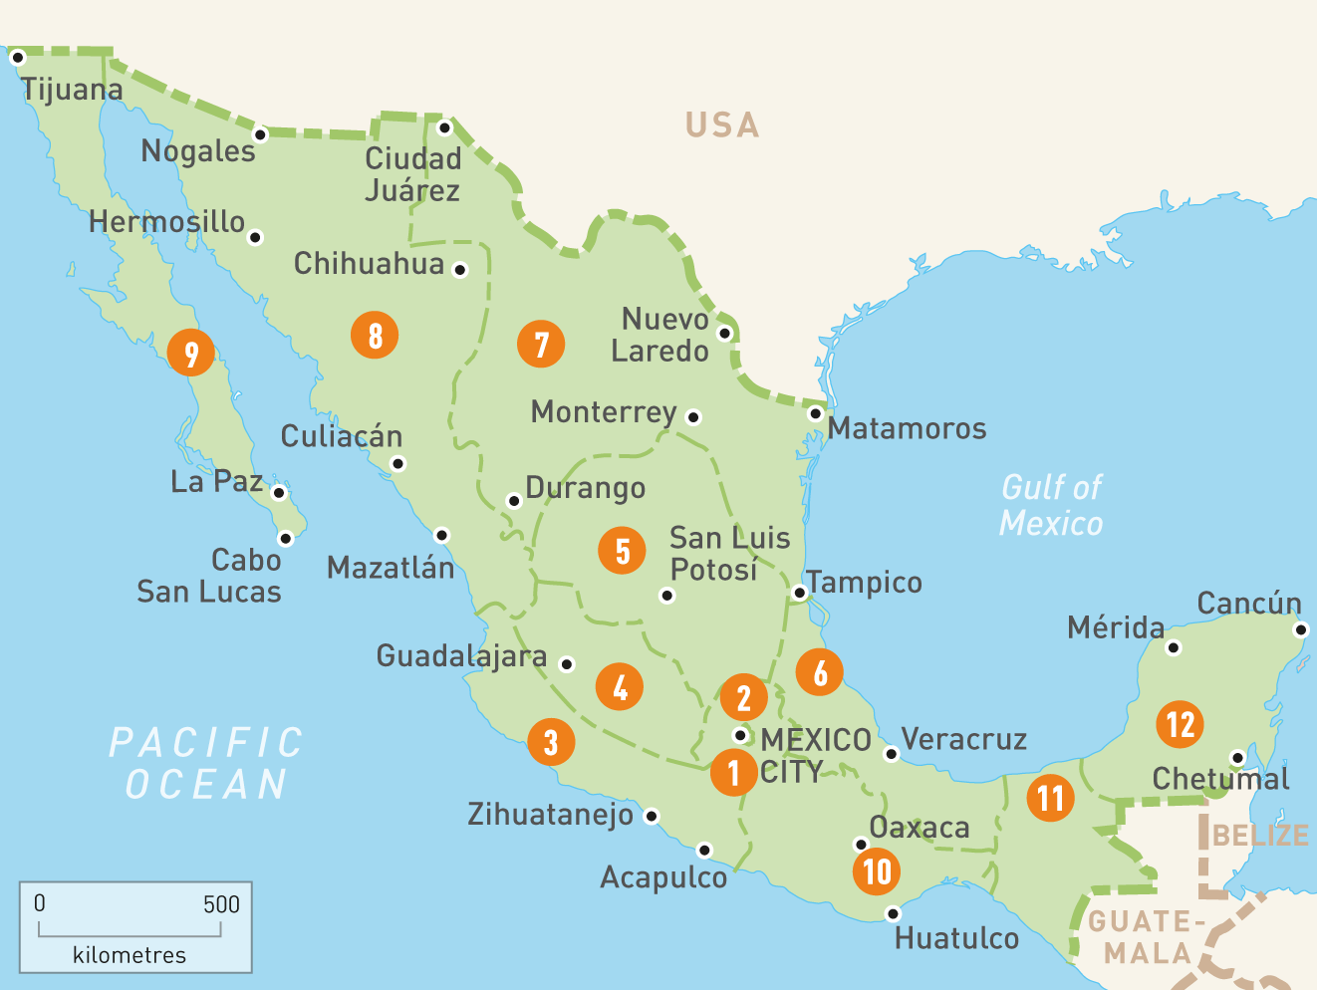

What is the most efficient route to visit all 12 cities?

Slide 15

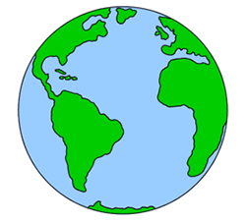
If we try all possible routes, for N cities we have to test (N-1)! possible routes.
5 cities: 4 * 3 * 2 * 1 = 24
10 cities: 9 * 8 * 7 * 6 * 5 * 4 * 3 * 2 * 1 = 362880
20 cities: 1.216 * 10^17 : Age of
the earth and sun in seconds
100 cities: 99 * 98 * 97 * … * 3 * 2 * 1
= 9.333 * 10^155: https://www.youtube.com/watch?v=7oCoLp1rJAw&t=49s
What are some examples of the travelling salesman problem in the real world?

Slide 16
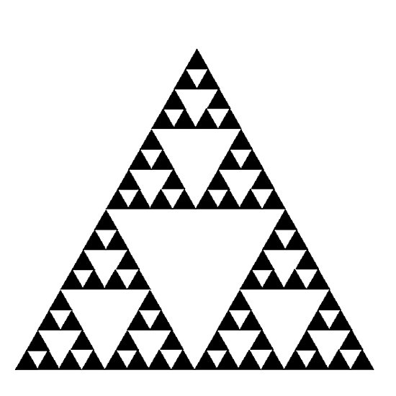

Fractals
Sierpinski’s Triangle
https://www.youtube.com/watch?v=PPu_94l0o8Q

Slide 17
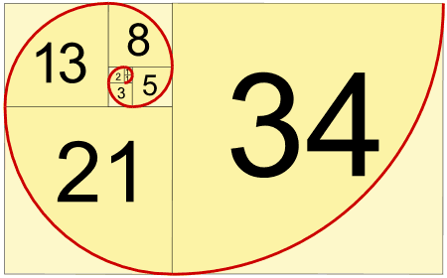
Fibonacci - the Golden Spiral
n1 = 0
n2 = 1
n3 = n2 + n1
n4 = n3 + n2
n5 = n4 + n3
n6 = n5 + n4
….
How can we generalize this pattern?
https://www.youtube.com/watch?v=DKGsBUxRcV0

Slide 18
Recursion
A recursive program calls itself until some condition is met.
fibonacci(number) { if (number <= 2)
return 1 else
return fibonacci(number-1) +
fibonacci(number-2)
}
Notes:
These are all examples of RECURSION

Slide 19
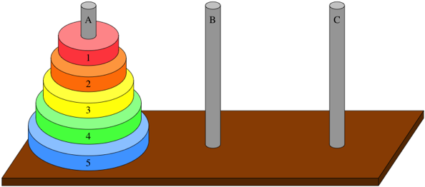
Towers of Hanoi

Slide 20
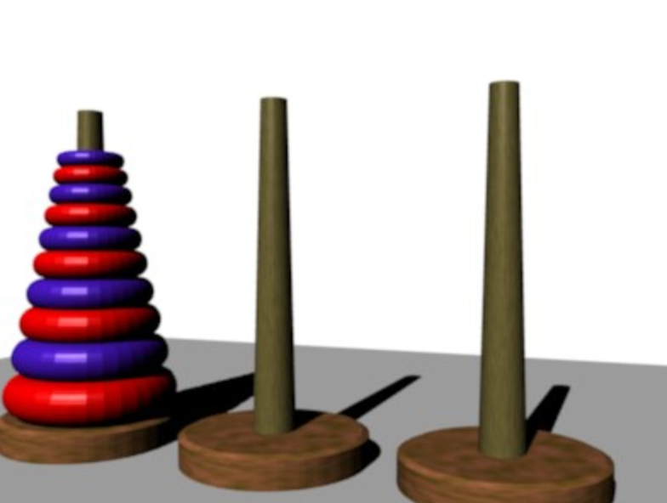
Hanoi Tournament
Decide on someone to represent your team!

Slide 21

Milestone 3
+
Final Project Worktime!

Slide 22
End of Day Task - Reflection

